Slide 1



Medical Education in Somaliland
Dr. Jinaw Mohamed Qalib

Slide 2
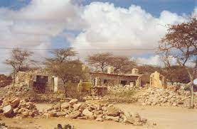
Somaliland After War
Some of the world’s worst, health indicators, Health worker shortage, small numbers of postgrad training opportunities, Young institutions.
A health workforce survey conducted in 2014 estimated there was 197 doctors serving a population of around 3.5 million - Whilst these numbers have increased, challenges remain with the extent to which health professionals are sufficiently trained to deliver safe, quality patient care ​

Slide 3

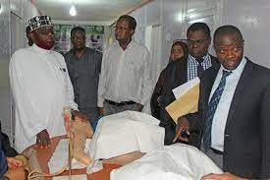

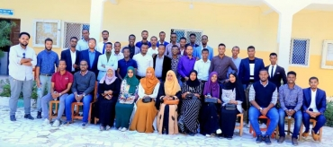

Somaliland Medical education history
Amoud University was set up in 2000
The first intake of students graduated in 2007 and continues.
up to 9 medical schools/collages in Somaliland
E.g.: Gollis, Edna, and more ,Both public and private
The First Somaliland undergraduate Harmonized medical Curriculum was developed
The First Medical school
Today
2020
Followed by
2018
University of Hargeisa 2003
First Medical Education Policy 2018 by Somaliland stakeholders , THET and Kings collage London

Slide 4


Partners
And also other partners whom contributed in more individual institutions.
King’s Global Health Partnerships
Partnership that dates back 23 years to 2000.
​King’s Global Health Partnerships works with health facilities, academic institutions and governments to strengthen health systems and improve the quality of care
They work closely with Ministries of Health to ensure their programmes respond to local needs and priorities and achieve sustainable change.
Tropical Health and Education Trust

Slide 5
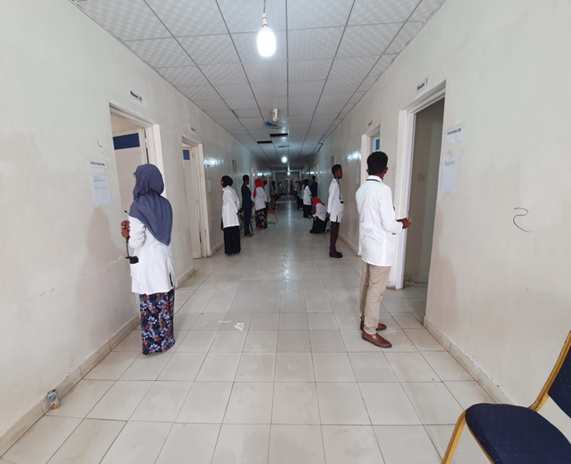
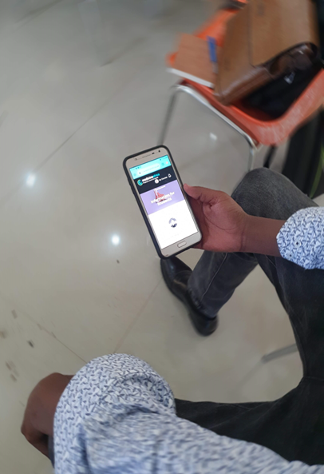
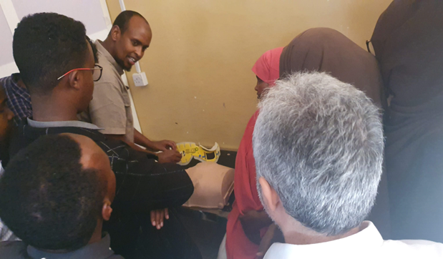
Undergraduate Medical education
Supporting undergraduate teaching, examination and clinical supervision;
Strengthening capacity of academic staff and teaching institutions;
Strengthening national governance and management of education for health professionals

Slide 6


Somaliland Internship Program:
Medical internship included development of a Standard Operating Policy (SOP), workplace-based assessments.
An increase in number of shifts provides round the clock staffing and more clinical exposure for interns • Interns are supervised by clinical supervisors who are now supported by specialist doctors • All interns now have the SOP, a contract and workplace-based assessment documentation at induction
Internship History
In Somaliland the internship program was initiated with the graduation of the first batch of medical students at 2007 and administrated by several stakeholders (SMA, HGH, BRH, and universities)
The internship is a crucial part of training for medical graduates, a 15 months , now 12 months rotations.)
Later on the internship transitioned to a National internship program run by the Ministry of Health.
Internship progress

Slide 7
Challenges internship program
Lacking of proper governance of the interns.
Lack of appropriate funding to support the supervisors and interns.

Slide 8
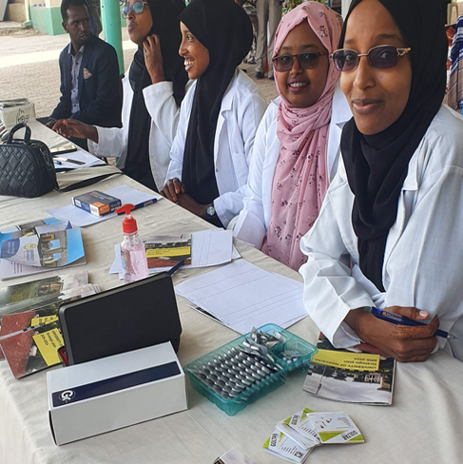
Medical education to the Future
Raising Demands in postgraduates specialty in the country.
Local specialty training highly appreciated and relevance to Somaliland context.
Fellowships
Post-speciality CPD courses.

Slide 9

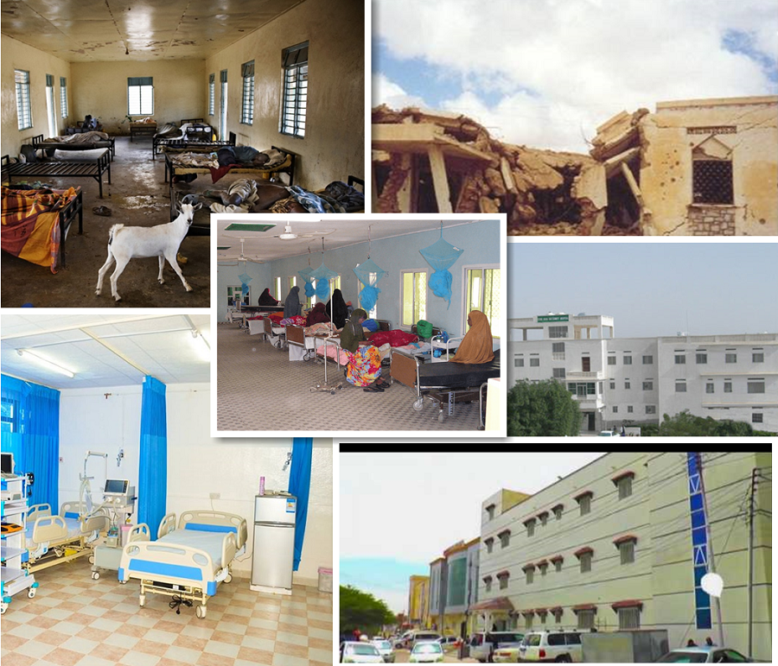
Thank you
jinawqalib@gmail.com
Just to add that medical education in Somaliland would not have come this far without dedicated and talented Somaliland faculty and students who want to improve health care.

